Slide 1
Department of Applied Mathematics and Computational Sciences
III Sem M.Sc.Software Systems
Transform Techniques
Dr. V. Suresh kumar

Slide 2
Properties

Slide 3
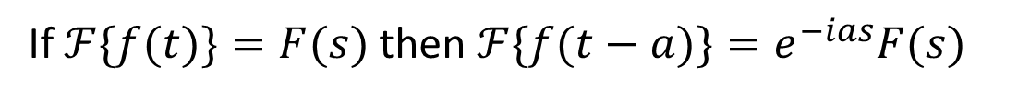
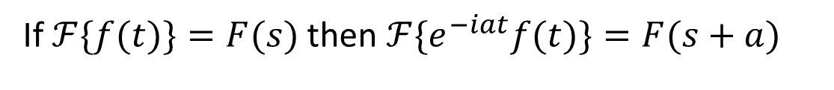
2. Change of scale property
1. Linear Property
If $ℱ\{f(t)\}=F(s)$and$ℱ\{g(t)\}= G(s)$ then$ℱ\{C_{1}f(t)+C_{2}g(t)\}=C_{1}F(s)+C_{2}G(s)$
If $ℱ\{f(t)\}=F(s)$ then $ℱ\{f(at)\}=\frac{1}{|a|}F\left(\frac{s}{a}\right)$
3. Shifting property (s-shifting)
If $ℱ\{f(t)\}=F(s)$ then $ℱ\{e^{−iat}f(t)\}=F(s+a)$
4. Shifting property (t-shifting)
If $ℱ\{f(t)\}=F(s)$ then $ℱ\{f(t−a)\}=e^{−ias}F(s)$

Slide 4
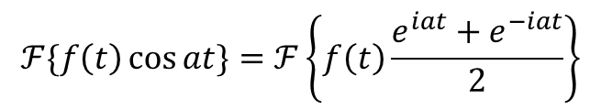
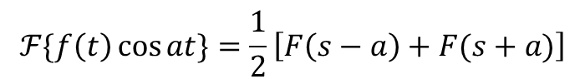
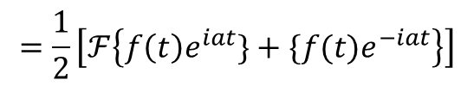
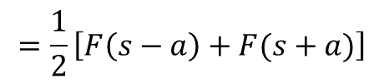
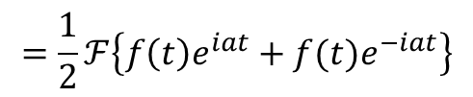
5. Modulation Property
If $ℱ\{f(t)\}=F(s)$ then $ℱ\{f\left(t\right)\cos{at}\}=\frac{1}{2}\left[F\left(s−a\right)+F(s+a)\right]$
Proof
$$ℱ\{f\left(t\right)\cos{at}\}=ℱ\left\{f\left(t\right)\frac{e^{iat}+e^{−iat}}{2}\right\}$$
$$=\frac{1}{2}ℱ\left\{f\left(t\right)e^{iat}+f(t)e^{−iat}\right\}$$
$$=\frac{1}{2}\left[ℱ\left\{f\left(t\right)e^{iat}\}+\{f(t)e^{−iat}\right\}\right]$$
$$=\frac{1}{2}\left[F\left(s−a\right)+F(s+a)\right]$$
$$ℱ\{f\left(t\right)\cos{at}\}=\frac{1}{2}\left[F\left(s−a\right)+F(s+a)\right]$$

Slide 5
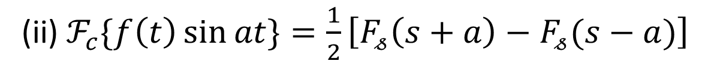
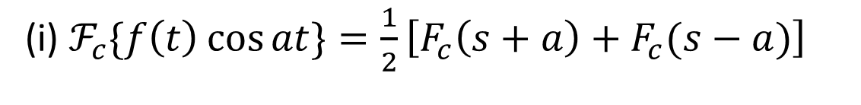
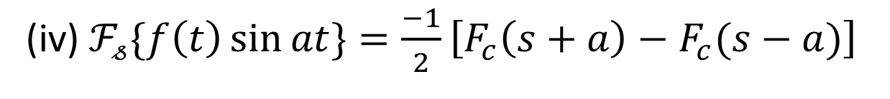
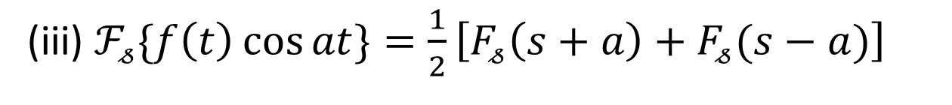
Modulation Properties for Sine and cosine Transform
(i) $ℱ_{c}\{f\left(t\right)\cos{at}\}=\frac{1}{2}\left[F_{c}\left(s+a\right)+F_{c}(s−a)\right]$
(ii) $ℱ_{c}\{f\left(t\right)\sin{at}\}=\frac{1}{2}\left[F_{𝓈}\left(s+a\right)−F_{𝓈}(s−a)\right]$
(iii) $ℱ_{𝓈}\{f\left(t\right)\cos{at}\}=\frac{1}{2}\left[F_{𝓈}\left(s+a\right)+F_{𝓈}(s−a)\right]$
(iv) $ℱ_{𝓈}\{f\left(t\right)\sin{at}\}=\frac{−1}{2}\left[F_{c}\left(s+a\right)−F_{c}(s−a)\right]$

Slide 6
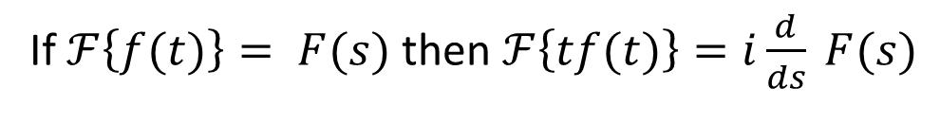
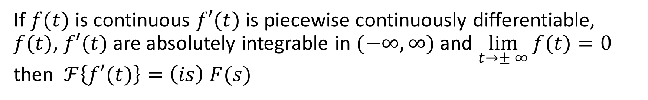
Transform of derivative
If $f(t)$ is continuous $f′(t)$is piecewise continuously differentiable, $f(t)$, $f′(t)$are absolutely integrable in $(−∞,∞)$ and $\lim_{t→± ∞}{f(t)}=0$ then $ℱ\left\{f′(t)\right\}=\left(is\right) F(s)$
Derivative of Transform
If $ℱ\left\{f(t)\right\}= F(s)$ then $ℱ\left\{tf(t)\right\}=i\frac{d}{ds} F(s)$

Slide 7

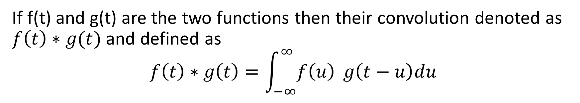
Faultang theorem
Definition
If f(t) and g(t) are the two functions then their convolution denoted as $f\left(t\right)∗g(t)$ and defined as
$$f\left(t\right)∗g\left(t\right)=\int_{−∞}^{∞}{f\left(u\right)} g\left(t−u\right)du$$
The Fourier Transform of the convolution of two functions is equal to the product of their Fourier Transforms.
$$ℱ\left\{f\left(t\right)∗g\left(t\right)\right\}=F\left(s\right)G(s)$$

Slide 8
Parseval’s identity (or) Energy theorem
If $ℱ\left\{f\left(t\right)\right\}=F(s)$ then $\int_{−∞}^{∞}{{\left|f\left(t\right)\right|}^{2}dt}=\int_{−∞}^{∞}{{\left|F\left(s\right)\right|}^{2}ds}$
In particular
(i) $\int_{0}^{∞}{f\left(t\right)g(t)dt}=\int_{0}^{∞}{F_{C}\left(s\right)G_{C}(s)ds}= \int_{0}^{∞}{F_{𝓈}\left(s\right)G_{𝓈}\left(s\right)ds}$
(ii) $\int_{0}^{∞}{{\left|f\left(t\right)\right|}^{2}dt}=\int_{0}^{∞}{{\left|F_{𝓈}\left(s\right)\right|}^{2}ds}=\int_{0}^{∞}{{\left|F_{C}\left(s\right)\right|}^{2}ds}$

Slide 9
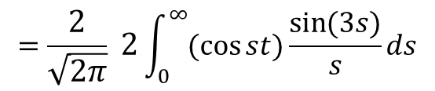

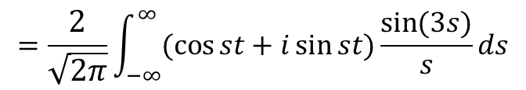
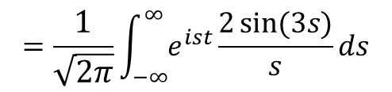
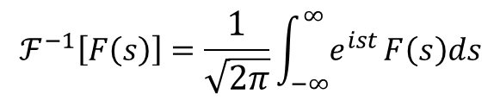

Example problems
1. Find the function $f(x)$for which the Fourier Transform is $\frac{2\sin{[3\left(s−2π\right)]}}{\left(s−2π\right)}$
Ans:
Take $F\left(s−2π\right)=\frac{2\sin{[3\left(s−2π\right)]}}{\left(s−2π\right)}$
$F\left(s\right)=\frac{2\sin{[3s]}}{s}$
$$ℱ^{−1}\left[F\left(s\right)\right]=\frac{1}{\sqrt{2π}}\int_{−∞}^{∞}{e^{ist}}F\left(s\right)ds$$
$$=\frac{1}{\sqrt{2π}}\int_{−∞}^{∞}{e^{ist}}\frac{2\sin{(3s)}}{s}ds$$
$$=\frac{2}{\sqrt{2π}}\int_{−∞}^{∞}{(\cos{st}+i\sin{st)}}\frac{\sin{(3s)}}{s}ds$$
$$=\frac{2}{\sqrt{2π}} 2\int_{0}^{∞}{(\cos{st}})\frac{\sin{(3s)}}{s}ds$$

Slide 10
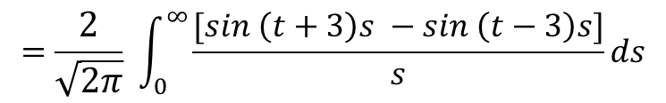
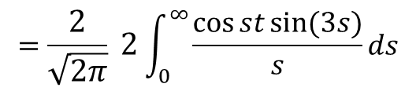
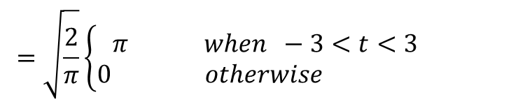
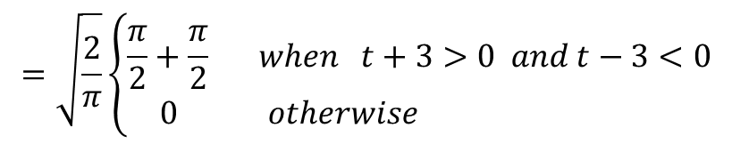
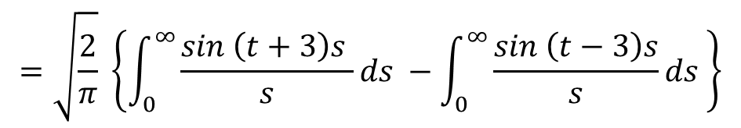
Problem contd…
$$=\frac{2}{\sqrt{2π}} 2\int_{0}^{∞}{\frac{\cos{st}sin{(3s)}}{s}}ds$$
$$=\frac{2}{\sqrt{2π}} \int_{0}^{∞}{\frac{[sin \left(t+3\right)s −sin \left(t−3\right)s]}{s}}ds$$
$$=\sqrt{\frac{2}{π}} \left\{\int_{0}^{∞}{\frac{sin \left(t+3\right)s }{s}}ds −\int_{0}^{∞}{\frac{sin \left(t−3\right)s}{s}}ds \right\}$$
$$=\sqrt{\frac{2}{π}}\left\{\begin{aligned}\frac{π}{2}+\frac{π}{2} when t+3>0 and t−3<0 \\ 0 otherwise \end{aligned}\right.$$
$$=\sqrt{\frac{2}{π}}\left\{\begin{aligned}π when −3<t<3 \\ 0 otherwise \end{aligned}\right.$$

Slide 11

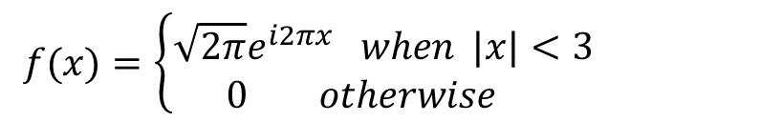
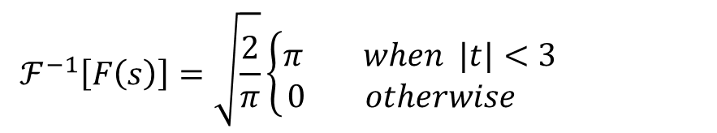
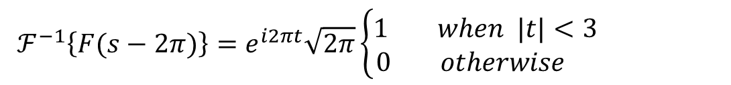


Problem contd…
$$ℱ^{−1}\left[F\left(s\right)\right]=\sqrt{\frac{2}{π}}\left\{\begin{aligned}π when |t|<3 \\ 0 otherwise \end{aligned}\right.$$
$$f(t)=\sqrt{2π}\left\{\begin{aligned}1 when |t|<3 \\ 0 otherwise \end{aligned}\right.$$
s-shifting
$$ℱ\{e^{−iat}f(t)\}=F(s+a)$$
$$ℱ^{−1}\left\{F(s+a)\right\}=e^{−iat}f\left(t\right)$$
$$ℱ^{−1}\left\{F(s−2π)\right\}=e^{i2πt}\sqrt{2π}\left\{\begin{aligned}1 when |t|<3 \\ 0 otherwise \end{aligned}\right.$$
$$f(x)=\left\{\begin{aligned}\sqrt{2π}e^{i2πx} when |x|<3 \\ 0 otherwise \end{aligned}\right.$$

Slide 12
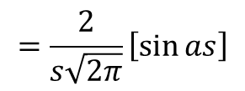
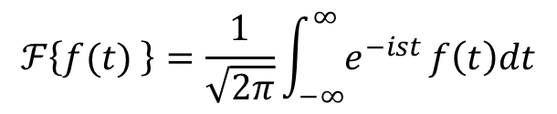
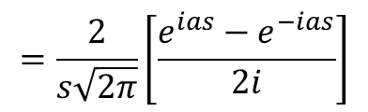
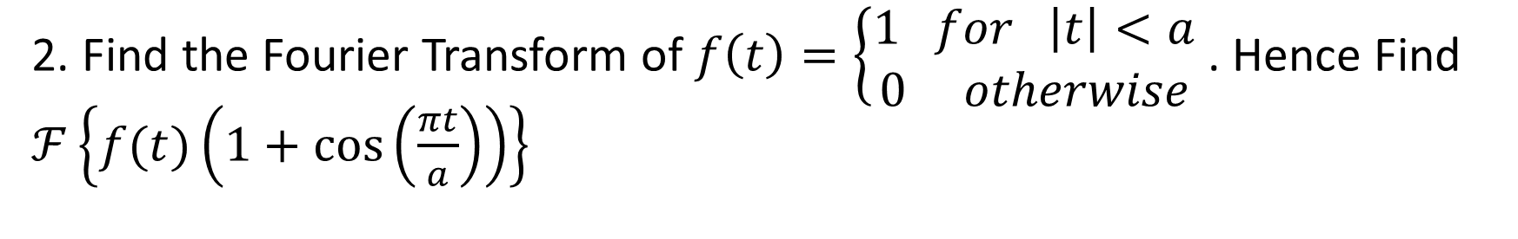
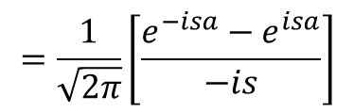
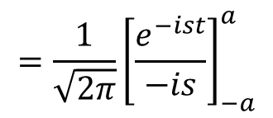

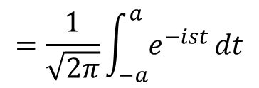
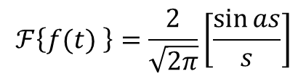
Example problems
2. Find the Fourier Transform of $f\left(t\right)=\left\{\begin{aligned}1 for \left|t\right|<a \\ 0 otherwise\end{aligned} \right.$. Hence Find $ℱ\left\{f(t)\left(1+\cos\left(\frac{πt}{a}\right)\right)\right\}$
Ans
$$ℱ\left\{f(t) \right\}=\frac{1}{\sqrt{2π}}\int_{−∞}^{∞}{e^{−ist}}f\left(t\right)dt$$
$$=\frac{2}{s\sqrt{2π}}\left[\frac{e^{ias}−e^{−ias}}{2i}\right]$$
$$=\frac{1}{\sqrt{2π}}\int_{−a}^{a}{e^{−ist}}dt$$
$$=\frac{2}{s\sqrt{2π}}\left[\sin{as}\right]$$
$$=\frac{1}{\sqrt{2π}}{\left[\frac{e^{−ist}}{−is}\right]}_{−a}^{a}$$
$$ℱ\left\{f(t) \right\}=\frac{2}{\sqrt{2π}}\left[\frac{\sin{as}}{s}\right]$$
$$=\frac{1}{\sqrt{2π}}\left[\frac{e^{−isa}−e^{isa}}{−is}\right]$$
$$=F(s)$$

Slide 13
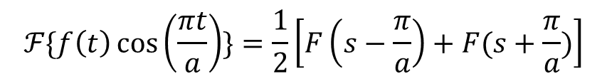
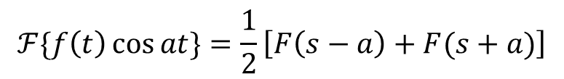
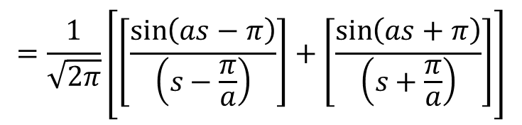
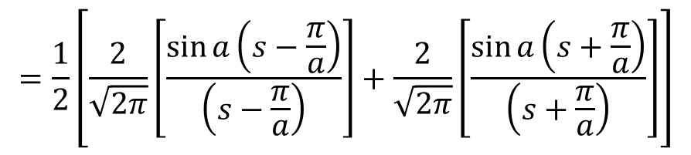
Problem contd…
Using Modulation property
$$ℱ\{f\left(t\right)\cos{at}\}=\frac{1}{2}\left[F\left(s−a\right)+F(s+a)\right]$$
$$ℱ\{f\left(t\right)\cos\left(\frac{πt}{a}\right)\}=\frac{1}{2}\left[F\left(s−\frac{π}{a}\right)+F(s+\frac{π}{a})\right]$$
$$=\frac{1}{2}\left[\frac{2}{\sqrt{2π}}\left[\frac{\sin{a\left(s−\frac{π}{a}\right)}}{\left(s−\frac{π}{a}\right)}\right]+\frac{2}{\sqrt{2π}}\left[\frac{\sin{a\left(s+\frac{π}{a}\right)}}{\left(s+\frac{π}{a}\right)}\right]\right]$$
$$=\frac{1}{\sqrt{2π}}\left[\left[\frac{\sin\left(as−π\right)}{\left(s−\frac{π}{a}\right)}\right]+\left[\frac{\sin\left(as+π\right)}{\left(s+\frac{π}{a}\right)}\right]\right]$$

Slide 14
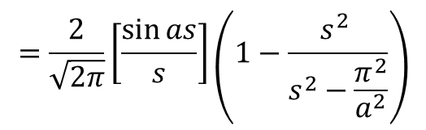
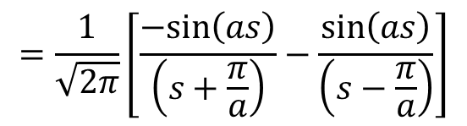
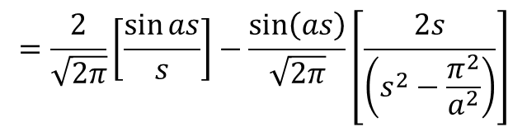
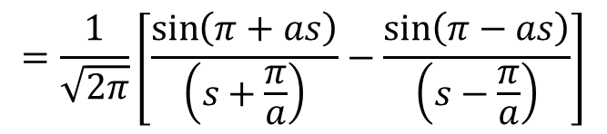

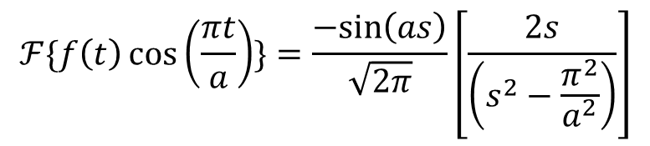
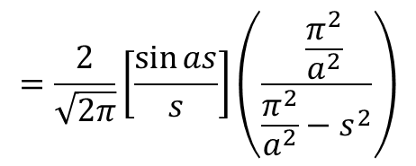
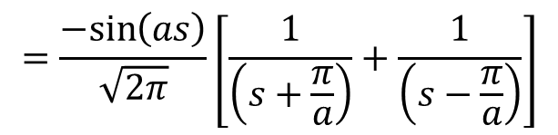
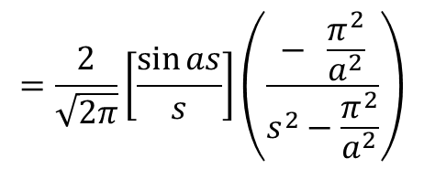
Problem contd…
$$ℱ\left\{f(t)\left(1+\cos\left(\frac{πt}{a}\right)\right)\right\}=ℱ\left\{f(t) \right\}+ℱ\{f\left(t\right)\cos\left(\frac{πt}{a}\right)\}$$
$$=\frac{1}{\sqrt{2π}}\left[\frac{\sin\left(π+as\right)}{\left(s+\frac{π}{a}\right)}−\frac{\sin\left(π−as\right)}{\left(s−\frac{π}{a}\right)}\right]$$
$$=\frac{2}{\sqrt{2π}}\left[\frac{\sin{as}}{s}\right]−\frac{\sin\left(as\right)}{\sqrt{2π}}\left[\frac{2s}{\left(s^{2}−\frac{π^{2}}{a^{2}}\right)}\right]$$
$$=\frac{1}{\sqrt{2π}}\left[\frac{−sin\left(as\right)}{\left(s+\frac{π}{a}\right)}−\frac{\sin\left(as\right)}{\left(s−\frac{π}{a}\right)}\right]$$
$$=\frac{2}{\sqrt{2π}}\left[\frac{\sin{as}}{s}\right]\left(1−\frac{s^{2} }{s^{2}−\frac{π^{2}}{a^{2}}}\right)$$
$$=\frac{−sin\left(as\right)}{\sqrt{2π}}\left[\frac{1}{\left(s+\frac{π}{a}\right)}+\frac{1}{\left(s−\frac{π}{a}\right)}\right]$$
$$=\frac{2}{\sqrt{2π}}\left[\frac{\sin{as}}{s}\right]\left(\frac{− \frac{π^{2}}{a^{2}}}{s^{2}−\frac{π^{2}}{a^{2}}}\right)$$
$$ℱ\{f\left(t\right)\cos\left(\frac{πt}{a}\right)\}=\frac{−sin\left(as\right)}{\sqrt{2π}}\left[\frac{2s}{\left(s^{2}−\frac{π^{2}}{a^{2}}\right)}\right]$$
$$=\frac{2}{\sqrt{2π}}\left[\frac{\sin{as}}{s}\right]\left(\frac{ \frac{π^{2}}{a^{2}}}{\frac{π^{2}}{a^{2}}−s^{2}}\right)$$

Slide 15
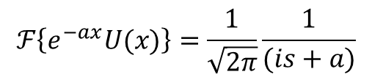
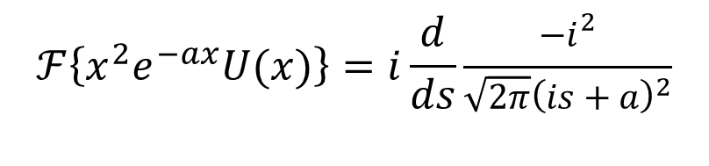
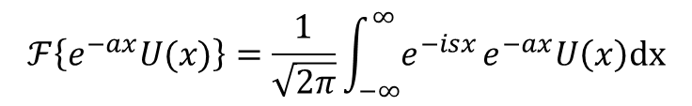
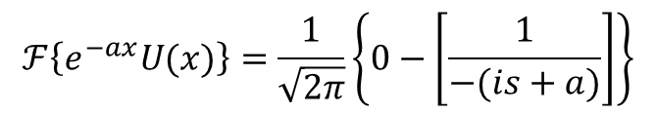








Example problems
$$ℱ\left\{e^{−ax}U(x)\right\}=\frac{1}{\sqrt{2π}}\left\{0−\left[\frac{1}{−(is+a)}\right]\right\}$$
3. Find $ℱ\left[x^{2}e^{−ax}U(x)\right]$
$$ℱ\left\{e^{−ax}U(x)\right\}=\frac{1}{\sqrt{2π}}\frac{1}{(is+a)}$$
Ans:
$$ℱ\left\{xf(x)\right\}=i\frac{d}{ds}ℱ\left\{f(x)\right\}$$
$$ℱ\left\{e^{−ax}U(x)\right\}=\frac{1}{\sqrt{2π}}\int_{−∞}^{∞}{e^{−isx}}e^{−ax}U\left(x\right)dx$$
$$ℱ\left\{x^{2}f(x)\right\}=i\frac{d}{ds}ℱ\left\{xf(x)\right\}$$
$$=\frac{1}{\sqrt{2π}}\int_{0}^{∞}{e^{−isx}}e^{−ax}dx$$
$$ℱ\left\{xe^{−ax}U(x)\right\}=i\frac{d}{ds}\frac{1}{\sqrt{2π}}\frac{1}{(is+a)}$$
$$=\frac{1}{\sqrt{2π}}\int_{0}^{∞}{e^{−(is+a)x}}dx$$
$$=\frac{i}{\sqrt{2π}}\frac{−i}{{\left(is+a\right)}^{2}}$$
$$ℱ\left\{x^{2}e^{−ax}U(x)\right\}=i\frac{d}{ds}\frac{−i^{2}}{{\sqrt{2π}\left(is+a\right)}^{2}}$$
$$=\frac{1}{\sqrt{2π}}{\left[\frac{e^{−(is+a)x}}{−(is+a)}\right]}_{0}^{∞}$$

Slide 16




Problem contd…
$$ℱ\left\{x^{2}e^{−ax}U(x)\right\}=\frac{−i^{3}}{\sqrt{2π}}\frac{d}{ds}\frac{1}{{\left(is+a\right)}^{2}}$$
$$=\frac{−i^{3}}{\sqrt{2π}}\frac{−2i}{{\left(is+a\right)}^{3}}$$
$$=\frac{i^{4}}{\sqrt{2π}}\frac{2}{{\left(is+a\right)}^{3}}$$
$$ℱ\left\{x^{2}e^{−ax}U(x)\right\}=\frac{2}{{\sqrt{2π}\left(is+a\right)}^{3}}$$

Slide 17





Example problems
4. Find the Fourier Transform of $\frac{\sin{ax}}{x}$ and hence prove that $\int_{−∞}^{∞}{\frac{\sin^{2}{ax}}{x^{2}}}dx=aπ, a>0$
Ans
$$ℱ\left\{\frac{\sin{ax}}{x}\right\}=\frac{1}{\sqrt{2π}}\int_{−∞}^{∞}{e^{−isx}\frac{\sin{ax}}{x}dx}$$
$$=\frac{2}{\sqrt{2π}}\int_{0}^{∞}{\cos{sx}\frac{\sin{ax}}{x}dx}$$
$$=\frac{1}{\sqrt{2π}}\int_{0}^{∞}{\frac{1}{x}\left[\sin\left(s+a\right)x−\sin\left(s−a\right)x\right]dx}$$
$$=\frac{1}{\sqrt{2π}}\left\{\int_{0}^{∞}{\frac{\sin\left(s+a\right)x}{x}dx}−\int_{0}^{∞}{\frac{\sin\left(s−a\right)x}{x}dx}\right\}$$

Slide 18










Problem contd…
$$\int_{−∞}^{∞}{{\left|f\left(x\right)\right|}^{2}dt}=\int_{−∞}^{∞}{{\left|F\left(s\right)\right|}^{2}ds}$$
$$=\frac{1}{\sqrt{2π}}\left\{\int_{0}^{∞}{\frac{\sin\left(s+a\right)x}{x}dx}−\int_{0}^{∞}{\frac{\sin\left(s−a\right)x}{x}dx}\right\}$$
$$=\frac{1}{\sqrt{2π}}\left\{\begin{aligned}\frac{π}{2}+\frac{π}{2} when s+a>0 and s−a<0 \\ 0 otherwise \end{aligned}\right.$$
$$\int_{−∞}^{∞}{{|\left(\frac{\sin{ax}}{x}\right)|}^{2}dt}=\int_{−a}^{a}{{\left|\frac{π}{\sqrt{2π}}\right|}^{2}ds}$$
$$=\frac{1}{\sqrt{2π}}\left\{\begin{aligned}π when −a<s<a \\ 0 otherwise \end{aligned}\right.$$
$$\int_{0}^{∞}{{\left(\frac{\sin{ax}}{x}\right)}^{2}dt}=\frac{π^{2}}{2π}2\int_{0}^{a}{ds}$$
$$ℱ\left\{\frac{\sin{ax}}{x}\right\}=\left\{\begin{aligned}\frac{π}{\sqrt{2π}} when |s|<a \\ 0 otherwise \end{aligned}\right.$$
$$\int_{0}^{∞}{{\left(\frac{\sin{ax}}{x}\right)}^{2}dt}=π{\left[s\right]}_{0}^{a}$$
$$\int_{0}^{∞}{{\left(\frac{\sin{ax}}{x}\right)}^{2}dt}=aπ$$
$$=F(s)$$
Using Parseval’s identity

Slide 19

Homework problem
Find the Fourier Transform of $f\left(x\right)=\left\{\begin{aligned}1−\left|x\right|, for \left|x\right|<1 \\ 0 otherwise\end{aligned}\right.$ Hence Prove that $\int_{0}^{∞}{\frac{\sin^{4}{ x}}{x^{4}} dx=\frac{π}{3}}$.

Slide 20


Example problems
5. Using Parseval’s identity for Fourier Sine and Cosine Transforms of $e^{−ax}$, evaluate $(i)\int_{0}^{∞}{\frac{dx}{{\left(a^{2}+x^{2}\right)}^{2}}}$ and $(ii)\int_{0}^{∞}{\frac{x^{2}dx}{{\left(a^{2}+x^{2}\right)}^{2}}}$.
Sine Transform
$$ℱ_{𝓈}\left\{f(x)\right\}=\sqrt{\frac{2}{π}}\int_{0}^{∞}{f\left(x\right) sin{sx} dx}$$
We have
and
$$f\left(x\right)=e^{−ax}$$
$$=\sqrt{\frac{2}{π}}\int_{0}^{∞}{e^{−ax}sin{sx} dx}$$
$$\int{e^{ax}\sin{bx }dx}=\frac{e^{ax}}{(a^{2}+b^{2})}\left\{asinbx−b\cos{bx}\right\}$$
$$=\sqrt{\frac{2}{π}}{\left\{\frac{e^{−ax}}{(a^{2}+s^{2})}\left[−a\sin{sx−s\cos{sx}}\right]\right\}}_{0}^{∞}$$
$$=\sqrt{\frac{2}{π}}\left\{\left[0\right]−\left[\frac{1}{(a^{2}+s^{2})}\left(0−s(1)\right)\right]\right\}$$
$$ℱ_{𝓈}\left\{f(x)\right\}=\sqrt{\frac{2}{π}}\frac{s}{(a^{2}+s^{2})}=F_{𝓈}(s)$$

Slide 21

Problem contd…
Cosine Transform
$$ℱ_{c}\left\{f(x)\right\}=\sqrt{\frac{2}{π}}\int_{0}^{∞}{f\left(x\right) cos{sx} dx}$$
We have
and
$$f\left(x\right)=e^{−ax}$$
$$=\sqrt{\frac{2}{π}}\int_{0}^{∞}{e^{−ax}cos{sx} dx}$$
$$\int{e^{ax}\cos{bx }dx}=\frac{e^{ax}}{(a^{2}+b^{2})}\left\{acosbx+b\sin{bx}\right\}$$
$$=\sqrt{\frac{2}{π}}{\left\{\frac{e^{−ax}}{(a^{2}+s^{2})}\left[−a\cos{sx+s\sin{sx}}\right]\right\}}_{0}^{∞}$$
$$=\sqrt{\frac{2}{π}}\left\{\left[0\right]−\left[\frac{1}{(a^{2}+s^{2})}\left(−a\right)\right]\right\}$$
$$ℱ_{c}\left\{f(x)\right\}=\sqrt{\frac{2}{π}}\frac{a}{(a^{2}+s^{2})}=F_{c}(s)$$

Slide 22











Problem contd…
$$ℱ_{c}\left\{f(x)\right\}=\sqrt{\frac{2}{π}}\frac{a}{(a^{2}+s^{2})}=F_{c}(s)$$
As
$$f\left(x\right)=e^{−ax}$$
We have
$\int_{0}^{∞}{{\left|f\left(x\right)\right|}^{2}dx}=\int_{0}^{∞}{{\left|F_{𝓈}\left(s\right)\right|}^{2}ds}=\int_{0}^{∞}{{\left|F_{C}\left(s\right)\right|}^{2}ds}$
$$\frac{2}{π}\int_{0}^{∞}{\frac{a^{2}}{{\left(a^{2}+s^{2}\right)}^{2}}ds}=\frac{1}{2a}$$
$\int_{0}^{∞}{{\left|f\left(x\right)\right|}^{2}dx}=\int_{0}^{∞}{{\left|F_{C}\left(s\right)\right|}^{2}ds}$
$\int_{0}^{∞}{{\left|e^{−ax}\right|}^{2}dx}=\int_{0}^{∞}{{\left|\sqrt{\frac{2}{π}}\frac{a}{(a^{2}+s^{2})}\right|}^{2}ds}$
$$\int_{0}^{∞}{\frac{a^{2}}{{\left(a^{2}+s^{2}\right)}^{2}}ds}=\frac{π}{4a}$$
$\int_{0}^{∞}{e^{−2ax}dx}=\frac{2}{π}\int_{0}^{∞}{\frac{a^{2}}{{\left(a^{2}+s^{2}\right)}^{2}}ds}$
$$\int_{0}^{∞}{\frac{dx}{{\left(a^{2}+x^{2}\right)}^{2}}=\frac{π}{4a^{3}}}$$
$$\frac{2}{π}\int_{0}^{∞}{\frac{a^{2}}{{\left(a^{2}+s^{2}\right)}^{2}}ds}={\left[\frac{e^{−2ax}}{−2a}\right]}_{0}^{∞}$$
$$=0−\left[\frac{1}{−2a}\right]$$

Slide 23









Problem contd…
$$ℱ_{𝓈}\left\{f(x)\right\}=\sqrt{\frac{2}{π}}\frac{s}{(a^{2}+s^{2})}=F_{𝓈}(s)$$
Take
$$f\left(x\right)=e^{−ax}$$
$\int_{0}^{∞}{{\left|f\left(x\right)\right|}^{2}dx}=\int_{0}^{∞}{{\left|F_{𝓈}\left(s\right)\right|}^{2}ds}=\int_{0}^{∞}{{\left|F_{C}\left(s\right)\right|}^{2}ds}$
$$\frac{2}{π}\int_{0}^{∞}{\frac{s^{2}}{{\left(a^{2}+s^{2}\right)}^{2}}ds}=\frac{1}{2a}$$
$\int_{0}^{∞}{{\left|f\left(x\right)\right|}^{2}dx}=\int_{0}^{∞}{{\left|F_{𝓈}\left(s\right)\right|}^{2}ds}$
$\int_{0}^{∞}{{\left|e^{−ax}\right|}^{2}dx}=\int_{0}^{∞}{{\left|\sqrt{\frac{2}{π}}\frac{s}{(a^{2}+s^{2})}\right|}^{2}ds}$
$$\int_{0}^{∞}{\frac{s^{2}}{{\left(a^{2}+s^{2}\right)}^{2}}ds}=\frac{π}{4a}$$
$\int_{0}^{∞}{e^{−2ax}dx}=\frac{2}{π}\int_{0}^{∞}{\frac{s^{2}}{{\left(a^{2}+s^{2}\right)}^{2}}ds}$
$$\int_{0}^{∞}{\frac{x^{2}dx}{{\left(a^{2}+x^{2}\right)}^{2}}=\frac{π}{4a}}$$
$$\frac{2}{π}\int_{0}^{∞}{\frac{s^{2}}{{\left(a^{2}+s^{2}\right)}^{2}}ds}={\left[\frac{e^{−2ax}}{−2a}\right]}_{0}^{∞}$$
$$=0−\left[\frac{1}{−2a}\right]$$

Slide 24






Example problems
6. Use Transform methods to evaluate $(i)\int_{0}^{∞}{\frac{dx}{(1+x^{2})(4+x^{2})}}$ and $(ii)\int_{0}^{∞}{\frac{x^{2}dx}{(a^{2}+x^{2})(b^{2}+x^{2})}}$.
Ans
$$ℱ_{c}\left\{f(x)\right\}=\sqrt{\frac{2}{π}}\frac{1}{(1+s^{2})}=F_{c}(s)$$
Take
$$f\left(x\right)=e^{−x}$$
$$ℱ_{c}\left\{g(x)\right\}=\sqrt{\frac{2}{π}}\frac{2}{(4+s^{2})}=G_{c}(s)$$
Take
$$g\left(x\right)=e^{−2x}$$
We have
$\int_{0}^{∞}{f\left(t\right)g(t)dt}=\int_{0}^{∞}{F_{C}\left(s\right)G_{C}(s)ds}= \int_{0}^{∞}{F_{𝓈}\left(s\right)G_{𝓈}\left(s\right)ds}$
$\int_{0}^{∞}{f\left(x\right)g(x)dx}=\int_{0}^{∞}{F_{C}\left(s\right)G_{C}(s)ds}$
$\int_{0}^{∞}{e^{−x}e^{−2x}dx}=\int_{0}^{∞}{\sqrt{\frac{2}{π}}\frac{1}{(1+s^{2})}\sqrt{\frac{2}{π}}\frac{2}{(4+s^{2})}ds}$

Slide 25







Problem contd…
$\int_{0}^{∞}{e^{−3x}dx}=\frac{2}{π}\int_{0}^{∞}{\frac{1}{(1+s^{2})}\frac{2}{(4+s^{2})}ds}$
$$\frac{2}{π}\int_{0}^{∞}{\frac{2}{(1+s^{2})(4+s^{2})}ds}=\int_{0}^{∞}{e^{−3x}dx}$$
$$={\left[\frac{e^{−3x}}{−3}\right]}_{0}^{∞}$$
$$=0−\left[\frac{1}{−3}\right]$$
$$\int_{0}^{∞}{\frac{dx}{(1+x^{2})(4+x^{2})}=\frac{π}{12}}$$
$$\frac{2}{π}\int_{0}^{∞}{\frac{2}{(1+s^{2})(4+s^{2})}ds=\frac{1}{3}}$$
$$\int_{0}^{∞}{\frac{2}{(1+s^{2})(4+s^{2})}ds=\frac{π}{6}}$$

Slide 26












Problem contd…
$$ℱ_{c}\left\{f(x)\right\}=\sqrt{\frac{2}{π}}\frac{s}{(a^{2}+s^{2})}=F_{c}(s)$$
Take
$$f\left(x\right)=e^{−ax}$$
$$ℱ_{c}\left\{g(x)\right\}=\sqrt{\frac{2}{π}}\frac{s}{(b^{2}+s^{2})}=G_{c}(s)$$
Take
$$g\left(x\right)=e^{−bx}$$
$\int_{0}^{∞}{f\left(t\right)g(t)dt}=\int_{0}^{∞}{F_{C}\left(s\right)G_{C}(s)ds}= \int_{0}^{∞}{F_{𝓈}\left(s\right)G_{𝓈}\left(s\right)ds}$
$\int_{0}^{∞}{f\left(x\right)g(x)dx}= \int_{0}^{∞}{F_{𝓈}\left(s\right)G_{𝓈}\left(s\right)ds}$
$$=0−\left[\frac{1}{−(a+b)}\right]$$
$\int_{0}^{∞}{e^{−ax}e^{−bx}dx}= \int_{0}^{∞}{\sqrt{\frac{2}{π}}\frac{s}{(a^{2}+s^{2})}\sqrt{\frac{2}{π}}\frac{s}{(b^{2}+s^{2})}ds}$
$$\frac{2}{π}\int_{0}^{∞}{\frac{s^{2}}{(a^{2}+s^{2})(b^{2}+s^{2})}ds}=\frac{1}{(a+b)}$$
$\int_{0}^{∞}{e^{−(a+b)x}dx}=\frac{2}{π}\int_{0}^{∞}{\frac{s^{2}}{(a^{2}+s^{2})(b^{2}+s^{2})}ds}$
$$\int_{0}^{∞}{\frac{x^{2}dx}{(a^{2}+x^{2})(b^{2}+x^{2})}=\frac{π}{ 2(a+b)}}$$
$$\frac{2}{π}\int_{0}^{∞}{\frac{s^{2}}{(a^{2}+s^{2})(b^{2}+s^{2})}ds}={\left[\frac{e^{−(a+b)x}}{−(a+b)}\right]}_{0}^{∞}$$

Slide 27


Note
From the section derivative of transform, we have
$${\left(i\right) ℱ}_{𝓈}\left\{xf(x)\right\}=−\frac{d}{ds}ℱ_{c}\left\{f(x)\right\}$$
$${\left(ii\right) ℱ}_{c}\left\{xf(x)\right\}=\frac{d}{ds}ℱ_{𝓈}\left\{f(x)\right\}$$

Slide 28






Example problems
7. Find the Fourier Cosine Transform of $xe^{−ax}$
Ans
$$ℱ_{𝓈}\left\{f(x)\right\}=\sqrt{\frac{2}{π}}\frac{s}{(a^{2}+s^{2})}=F_{𝓈}(s)$$
Take
$$f\left(x\right)=e^{−ax}$$
As
$${ ℱ}_{c}\left\{xf(x)\right\}=\frac{d}{ds}ℱ_{𝓈}\left\{f(x)\right\}$$
$${ ℱ}_{c}\left\{xe^{−ax}\right\}=\frac{d}{ds}\sqrt{\frac{2}{π}}\frac{s}{(a^{2}+s^{2})}$$
$$=\sqrt{\frac{2}{π}}\left\{\frac{\left(a^{2}+s^{2}\right)\left(1\right)−s(2s)}{{\left(a^{2}+s^{2}\right)}^{2} }\right\}$$
$$=\sqrt{\frac{2}{π}}\left\{\frac{\left(a^{2}−s^{2}\right)}{{\left(a^{2}+s^{2}\right)}^{2} }\right\}$$

Slide 29








Example problems
8. Find the Fourier Sine Transform of $xe^{−a^{2}x^{2}}$
Ans
$$ℱ\left\{e^{{−a}^{2}x^{2}}\right\}=\frac{e^{− \frac{s^{2}}{{4a}^{2}}}}{a\sqrt{2}}$$
Take
$$f\left(x\right)=e^{−a^{2}x^{2}}$$
As
$$ℱ_{c}\left\{e^{{−a}^{2}x^{2}}\right\}=ℱ\left\{e^{{−a}^{2}x^{2}}\right\}$$
$$=−\frac{1}{a\sqrt{2}}e^{− \frac{s^{2}}{{4a}^{2}}}\left(−\frac{2s}{4a^{2}}\right)$$
$$ℱ_{c}\left\{e^{{−a}^{2}x^{2}}\right\}=\frac{e^{− \frac{s^{2}}{{4a}^{2}}}}{a\sqrt{2}}$$
$${ ℱ}_{𝓈}\left\{xf(x)\right\}=−\frac{d}{ds}ℱ_{c}\left\{f(x)\right\}$$
$${ ℱ}_{𝓈}\left\{xe^{{−a}^{2}x^{2}}\right\}=\frac{2s}{4a^{3}\sqrt{2}}e^{− \frac{s^{2}}{{4a}^{2}}}$$
$${ ℱ}_{𝓈}\left\{xe^{{−a}^{2}x^{2}}\right\}=−\frac{d}{ds}\frac{e^{− \frac{s^{2}}{{4a}^{2}}}}{a\sqrt{2}}$$

Slide 30

Fourier Integral Formula
Fourier integral representation of $f(x)$
Where

Slide 31
Fourier Sine and Cosine Integral representation
If $f(x)$is an even function in $(−∞,∞)$ then the Fourier Integral becomes
Fourier Cosine Integral representation
where
If $f(x)$is an odd function in $(−∞,∞)$ then the Fourier Integral becomes
Fourier Sine Integral representation
where

Slide 32


